Slide 1
MONGODB -SHARDING AND REPLICATION
Done By:
Thahira Shajahan
Roll no:55

Slide 2
MONGODB
MongoDB is an open-source document database and leading NoSQL database.
MongoDB works on concept of collection and document.
Rather than using the tables and fixed schemas of a relational database management system(RDBMS), MongoDB uses key-value storage in the collection of documents.
It also supports a number of options for horizontal scaling in large, production environments.

Slide 3
MONGODB SHARDING
MongoDB supports sharding to provide scale-out capabilities and replication for high availability.
SHARDING is the process of writing data across different servers to distribute the read and write load and data storage requirements.
As the size of the data increases, a single machine may not be sufficient to store the data nor provide an acceptable read and write throughput.
Sharding solves the problem with horizontal scaling.

Slide 4
MONGODB SHARDING
MongoDB sharding works by creating a cluster of MongoDB instances consisting of at least three servers.
That means sharded clusters consist of three main components:
The Shard
Mongos
Config servers

Slide 5
SHARD
A Shard is a single MongoDB instance that holds a subset of the sharded data.
The combination of multiple shards creates a complete data set.
For example, a 2 TB data set can be broken down into four shards, each containing 500 GB of data from the original data set.

Slide 6
MONGOS
Mongos act as the query router providing a stable interface between the application and the sharded cluster.
This MongoDB instance is responsible for routing the client requests to the correct shard.

Slide 7
CONFIG SERVERS
Configuration servers store the metadata and the configuration settings for the whole cluster.

Slide 8
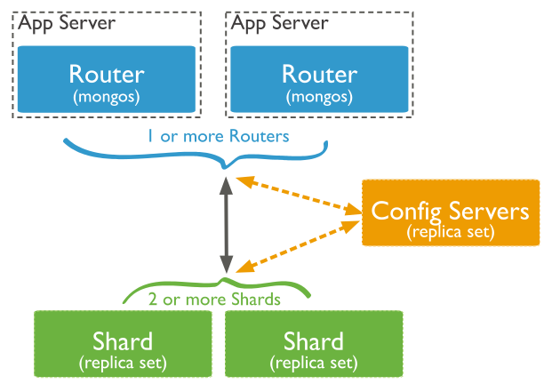
SHARDING

Slide 9
MONGODB REPLICATION
In MongoDB, data can be replicated across machines by the means of replica sets.
A replica set consists of a primary node together with two or more secondary nodes.
The primary node accepts all write requests,which are propagated asynchronously to the secondary nodes.
To be eligible to become primary, a node must be able to contact more than half of the replica set. This ensures that if a network partitions a replica set in two, only one of the partitions will attempt to establish a primary.

Slide 10
MONGODB REPLICATION
The successful primary will be elected based on the number of nodes to which it is in contact, together with a priority value that may be assigned by the system administrator.
Setting a priority of 0 to an instance prevents it from ever being elected as primary. In the event of a tie, the server with the most recent optime the timestamp of the last operation—will be selected..

Slide 11
MONGODB REPLICATION
The primary stores information about document changes in a collection within its local database, called the oplog. The primary will continuously attempt to apply these changes to secondary instances.
Members within a replica set communicate frequently via heartbeat messages. If a primary finds it is unable to receive heartbeat messages from more than half of the secondaries, then it will renounce its primary status and a new election will be called.

Slide 12
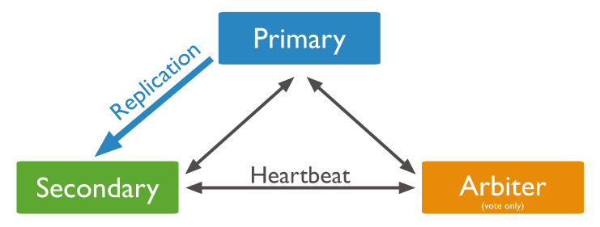
MONGODB REPLICATION

Slide 13
THANK YOU

